Slide 1


Yelp Reviews:
Restaurant Edition
Alex, Andalib, Kevin, Kimberly, Steven

Slide 2
Model Prediction
Prediction:
To predict whether a restaurant is good or bad in the United States based on specific features
Assumption:
3 Stars or above is good
Features: stars, state, attributes, categories

Slide 3




Methods and Data:
Yelp Dataset uploaded to an S3 Bucket on AWS:
https://yelpproject4.s3.amazonaws.com/yelp_restaurants.csv
Used PySpark to Read in the Data.
Also ran our analysis in PySpark
Ran different models including:
Random Forest, Logistic, and Neural Network
Predict
Fit
Model

Slide 4
Data Cleaning and Preprocessing
First available data came from Kaggle reflecting Arizona restaurants
The additional data comes from Yelp’s academic challenge dataset
https://www.yelp.com/dataset
Dataset contains:
8,635,403 reviews
160,585 businesses
8 metropolitan areas
Total: ~7GB of data
Used import tarfile and tarfile.open to extract the .json files from the .tar file
Business_data inside tarfile is a json file which is converted to CSV
Dropped duplicates and nulls.
The dataset reflects metropolitan areas and including Austin, Boulder, Boston, etc.

Slide 5
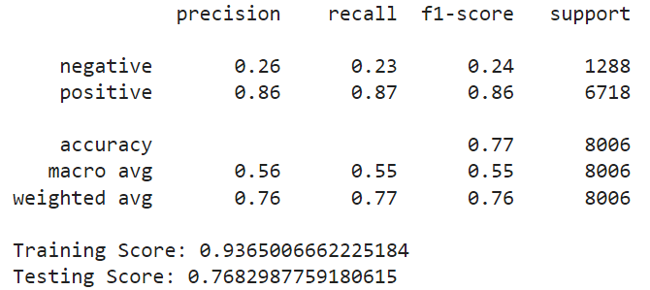
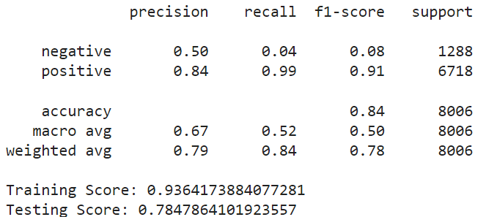
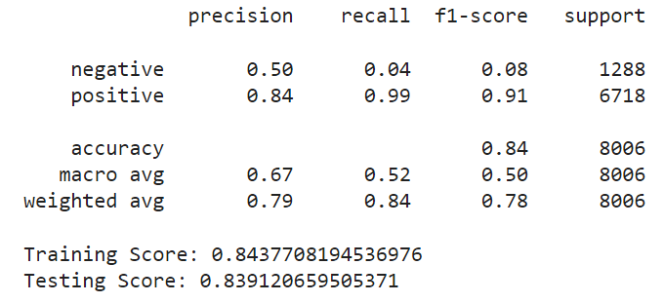
Model-A Random Forest
Random Forest
Extra Tree Classifier
Ada Boost Classifier

Slide 6
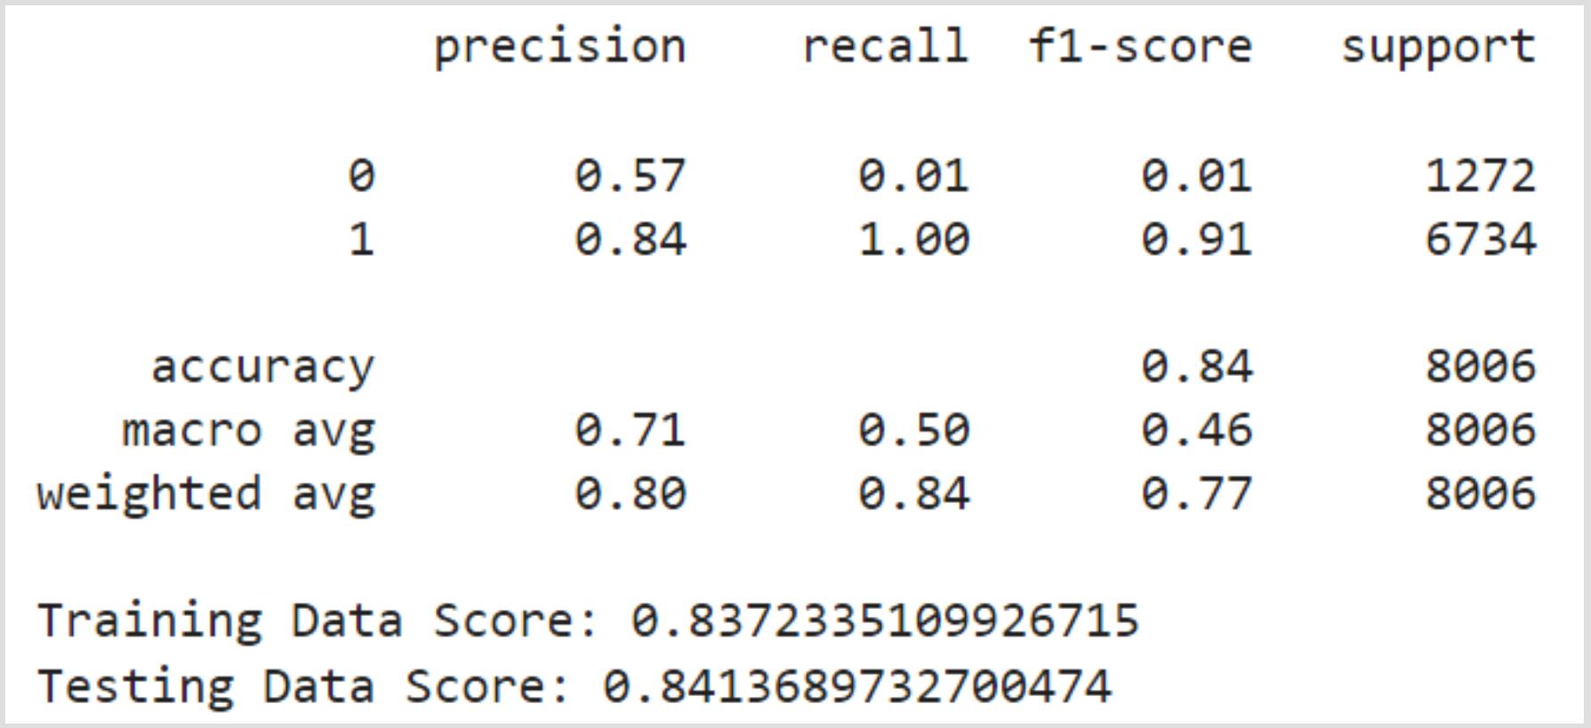
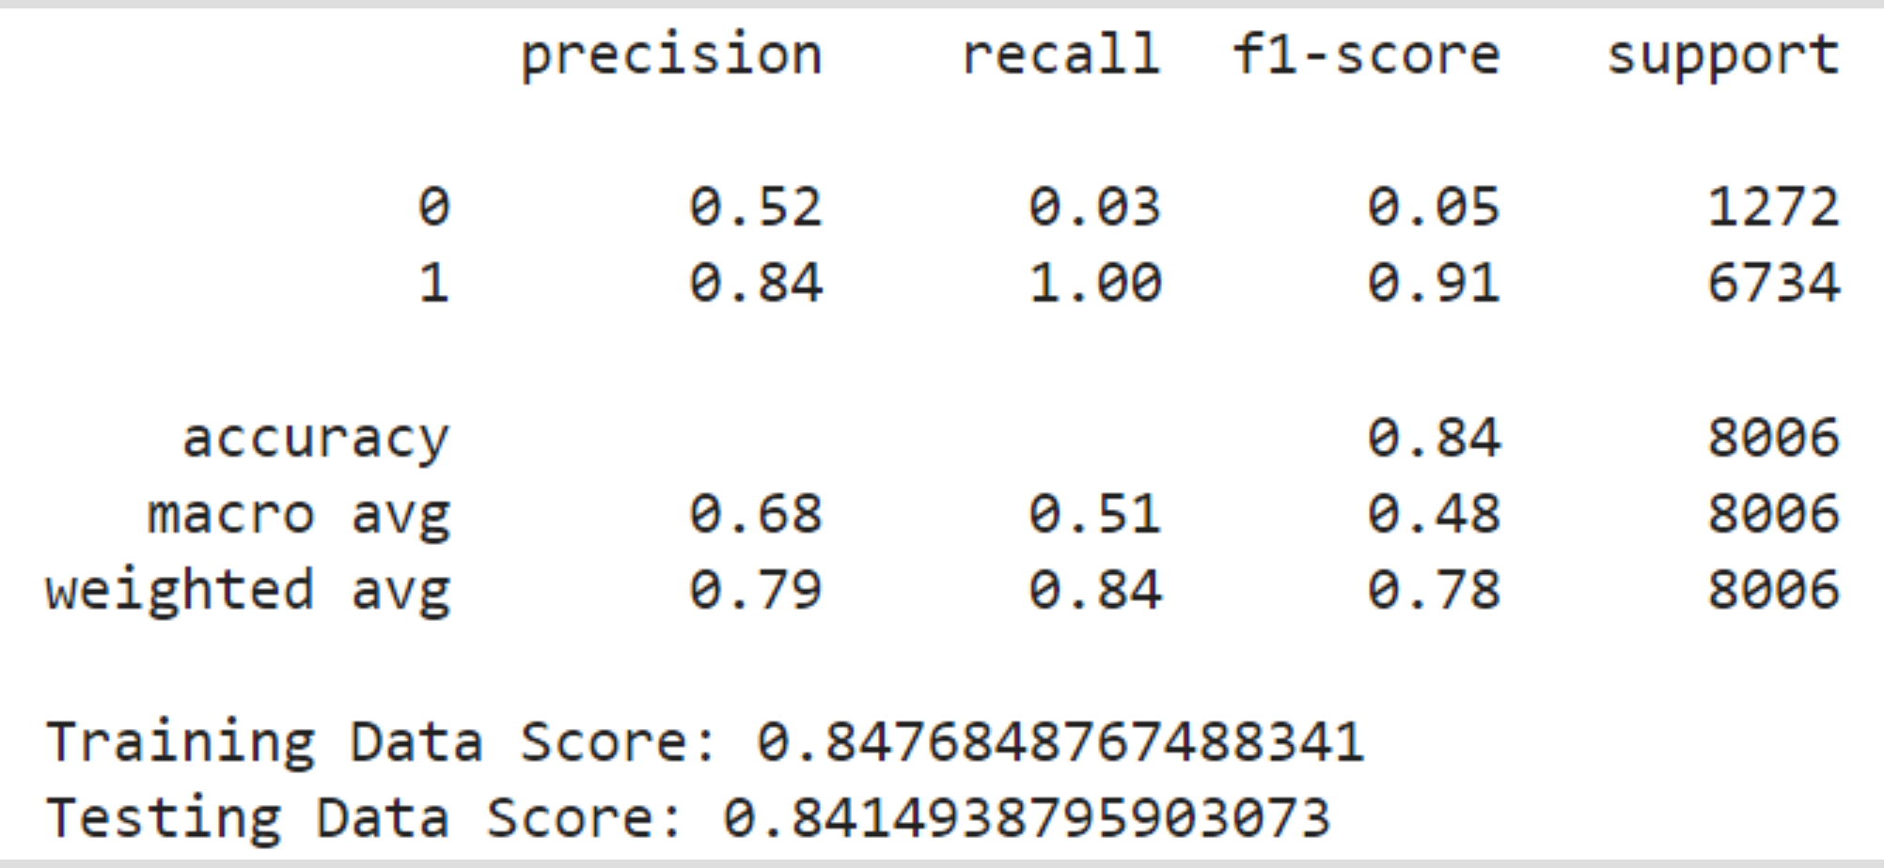
Model-B Logistic Regression
Scaled
Unscaled

Slide 7
Model C: Deep Neural Network
Best model hyperparameters:
'activation': 'tanh', 'first_units': 6, 'num_layers': 1, 'tuner/bracket': 2, 'tuner/epochs': 3,
Loss: 0.3861067295074463,
Accuracy: 0.841993510723114
We do not see significant improvement on the logistic regression model.

Slide 8
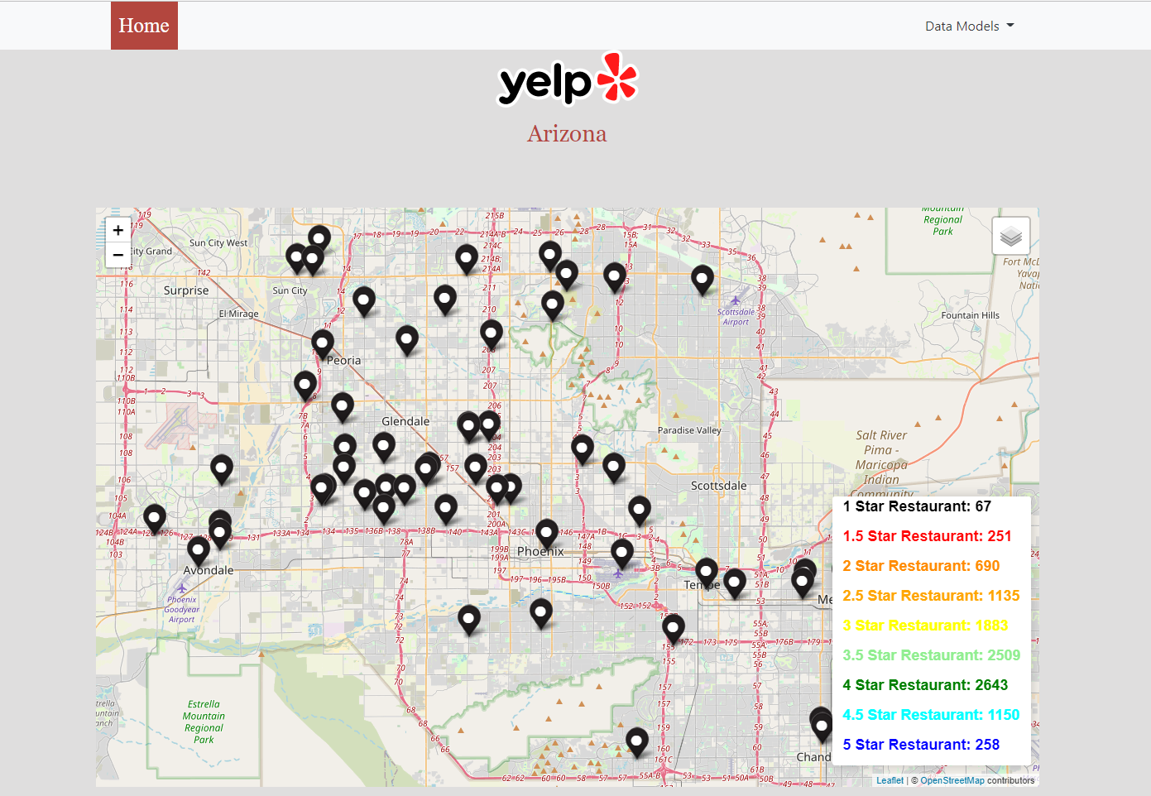
Website Demo
Link to Yelp Analysis Website

